Slide 1
Sinusoidal Steady-State Analysis
We consider circuits energized by time-varying voltage or current sources.
Textbook:
Electric Circuits
James W. Nilsson & Susan A. Riedel
9th Edition.

Slide 2
Outline
Complex Numbers Tutorial
Sinusoids
Phasors
Techniques of Circuit Analysis
Phasor Diagrams

Slide 3
The transformer
A transformer is a device that is based on magnetic coupling.
Are used in both communication and power circuits.
In communication circuits: transformer is used to matched impedance and eliminate dc signals from portions of the systems
In power circuits: transformer is used to establish ac voltage levels that facilitate the transmission, distribution and consumption of electrical power.

Slide 4
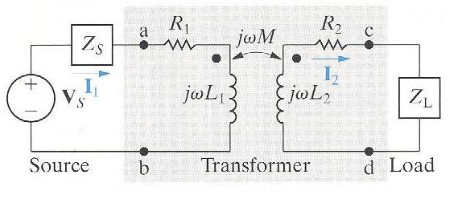
Linear transformer
Primarily used in communication circuits.
Is formed when two coils are wound on a single core to ensure magnetic coupling.
Frequency domain circuit model of a transformer
R₁ = the resistance of the primary winding
R₂ = the resistance of the secondary winding
L₁ = the self-inductance of the primary winding
L₂ = the self-inductance of the secondary winding
M = the mutual inductance
V_{s} = sinusoidal source
Z_{s} = internal impedance of the source
Z_{L} = the load
I₁ = primary current
I₂ = secondary current
Primary winding
Secondary winding

Slide 5
Transformer circuit analysis
Mesh-current equations:
Yield:

Slide 6
Transformer circuit analysis
Impedance at the terminal of the source:
Z_{ab} is independent of the magnetic polarity of the transformer.
Z_{ab} shows how the transformer affects the impedance of the load as seen from the source

Slide 7
Reflected impedance
Z_{r} = reflected impedance
= the impedance of the secondary circuit as seen from
the terminals of the primary circuit or vice versa.
Notes:
The reflected impedance is due solely to the existence of mutual inductance
The linear transformer reflects the conjugate of the self-impedance of the secondary circuit (Z*₂₂) into the primary winding by a scalar multiplier
Z*₂₂

Slide 8
Example
The parameters of a certain linear transformer are R₁ = 200 Ω, R₂ = 100 Ω, L₁ = 9H, L₂ = 4H, and k = 0.5. The transformer couples an impedance consisting of an 800 Ω resistor in series with a 1 μF capacitor to a sinusoidal voltage source. The 300 V (rms) source has an internal impedance of 500 + j100 Ω and a frequency of 400 rad/s.
a) Construct a frequency-domain equivalent circuit of the system.
b) Calculate the self-impedance of the primary circuit.
c) Calculate the self-impedance of the secondary circuit.
d) Calculate the impedance reflected into the primary winding.
e) Calculate the scaling factor for the reflected impedance.
f) Calculate the impedance seen looking into the primary terminals of the transformer.
g) Calculate the Thevenin equivalent with respect to the terminals c, d.

Slide 9
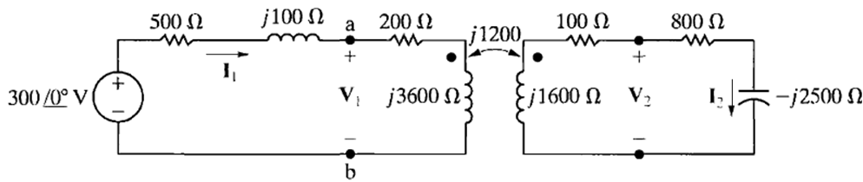
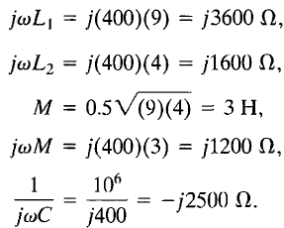
Example – Sol.
The figure shows the frequency-domain equivalent circuit. Note that the internal voltage of the source serves as the reference phasor, and that
V₁ and V₂ represent the terminal voltages of the transformer. In the circuit of the figure, we made the following calculations:

Slide 10
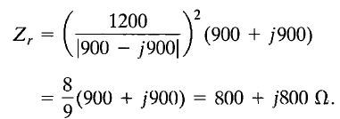
Example – Sol.
b) The self-impedance of the primary circuit is
Z₁₁ = 500 + j100 + 200 + j3600 = 700 + j3700 Ω.
c) The self-impedance of the secondary circuit is
Z₂₂ = 100 + j1600 + 800 - j2500 = 900 - j900 Ω.
d) The impedance reflected into the primary winding is
e) The scaling factor by which Z*₂₂ is reflected is 8/9.
f) The impedance seen looking into the primary terminals of the transformer is the impedance of the primary winding plus the reflected impedance; thus
Z_{ab} = 200 + j3600 + 800 + j800 = 1000 + j4400 Ω.

Slide 11




Example – Sol.
g) The Thevenin voltage will equal the open circuit value of V_{cd}. The open circuit value of V_{cd} will equal j1200 times the open circuit value of I₁.
The open circuit value of I₁ is
Therefore
The Thevenin impedance will be equal to the impedance of the secondary winding plus the impedance reflected from the primary when the voltage source is replaced by a short-circuit. Thus

Slide 12
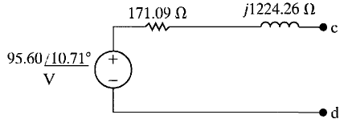
Example – Sol.
The Thevenin equivalent is shown in the figure bellow

Slide 13
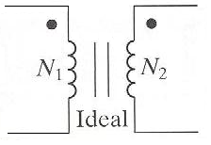
Ideal transformer
Usually used to model the ferromagnetic transformer in power systems.
An ideal transformer consists of two magnetically coupled coils having N1 and N2 turns, respectively, and exhibiting these three properties:
1) The coefficient of coupling is unity (k = 1)
2) The self-inductance of each coil is infinite (L₁ = L₂ = ∞)
3) The coil losses, due to parasitic resistance, are negligible (R₁ = R₂ = 0)

Slide 14
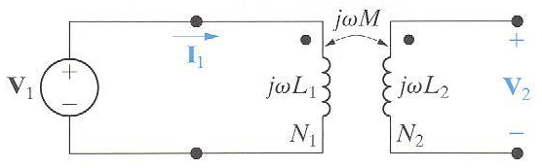
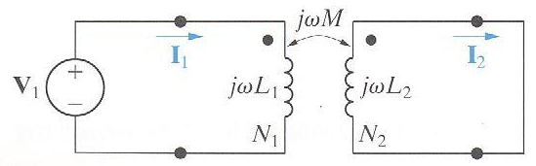
Ideal transformer
The circuit behavior is governed by the turns ratio a = N₂/N₁
Volts per turns is the same for each winding
Ampere turns are the same for each winding
If the coil voltages V1 and V2 are both positive or negative at the dot-marked terminal, use a plus (+) sign. Otherwise, use a negative (-) sign.
If the coil current I1 and I2 are both directed into or out of the dot-marked terminal, use a minus (-) sign. Otherwise, use a plus (+) sign.

Slide 15
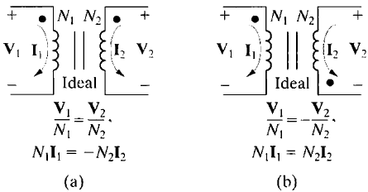
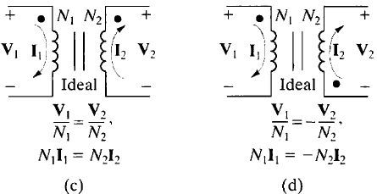

Slide 16
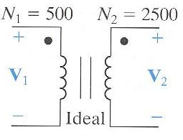
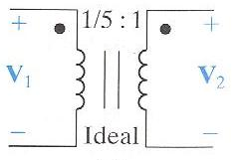
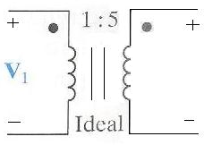
Ideal transformer
Turns ratio:
Three ways to show the turns ratio of an ideal transformer
V₂

Slide 17
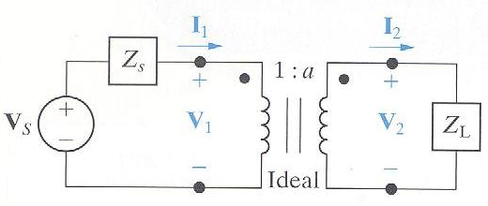
Impedance matching by using ideal transformer
Relation of V₁ and I₁ by the transformer turns ratio:
Impedance seen by the source and load respectively:
Yield:
The ideal transformer’s secondary coil reflects the load impedance back to the primary coil with the scaling factor 1/a².

